Slide 1

SQL Server Administration & Azure Data Engineering
Day 9

Slide 2

Agenda
Azure SQL Elastic Pools Overview
Azure Blob Storage Overview
Azure Data Lake Gen2 Storage
Azure Databricks Introduction
Components of Databricks
Working principles of Databricks

Slide 3
Azure SQL Server Elastic Pools
Azure SQL Database elastic pools are a shared resource model designed to manage and scale multiple databases that have varying and unpredictable usage demands.
Instead of provisioning dedicated resources for each database, you purchase a collective set of resources—either eDTUs or vCores—that all databases in the pool share

Slide 4
Real time Scenario to use Azure SQL Elastic Pool
SaaS Applications: When providing a dedicated database for each customer (tenant) where usage patterns are different and unpredictable.
Low Average Utilization: Databases that have low average usage but infrequent, sharp spikes in activity.
Varying Peak Times: When multiple databases do not peak simultaneously, allowing them to effectively share the pool's capacity

Slide 5
Azure Blob Storage Overview
Azure Blob Storage is Microsoft's object storage solution for the cloud. Blob Storage is optimized for storing massive amounts of unstructured data. Unstructured data is data that doesn't adhere to a particular data model or definition, such as text or binary data.
Serving images or documents directly to a browser.
Storing files for distributed access.
Streaming video and audio.
Writing to log files.
Storing data for backup and restore, disaster recovery, and archiving.
Storing data for analysis by an on-premises or Azure-hosted service.

Slide 6
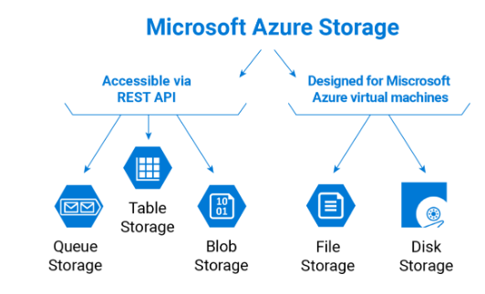
Azure Storage Types

Slide 7
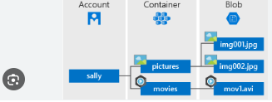
Azure Blob Storage Components
Azure Blob storage contains the following components.
Account
Container
Blob

Slide 8
Azure Data Lake Storage Gen2
Azure Data Lake Storage isn't a dedicated service or account type. Instead, it's implemented as a set of capabilities that you use with the Blob Storage service of your Azure Storage account. You can unlock these capabilities by enabling the hierarchical namespace setting.
Data Lake Storage includes the following capabilities.
✓ Hadoop-compatible access
✓ Hierarchical directory structure
✓ Optimized cost and performance
✓ Finer grain security model
✓ Massive scalability

Slide 9
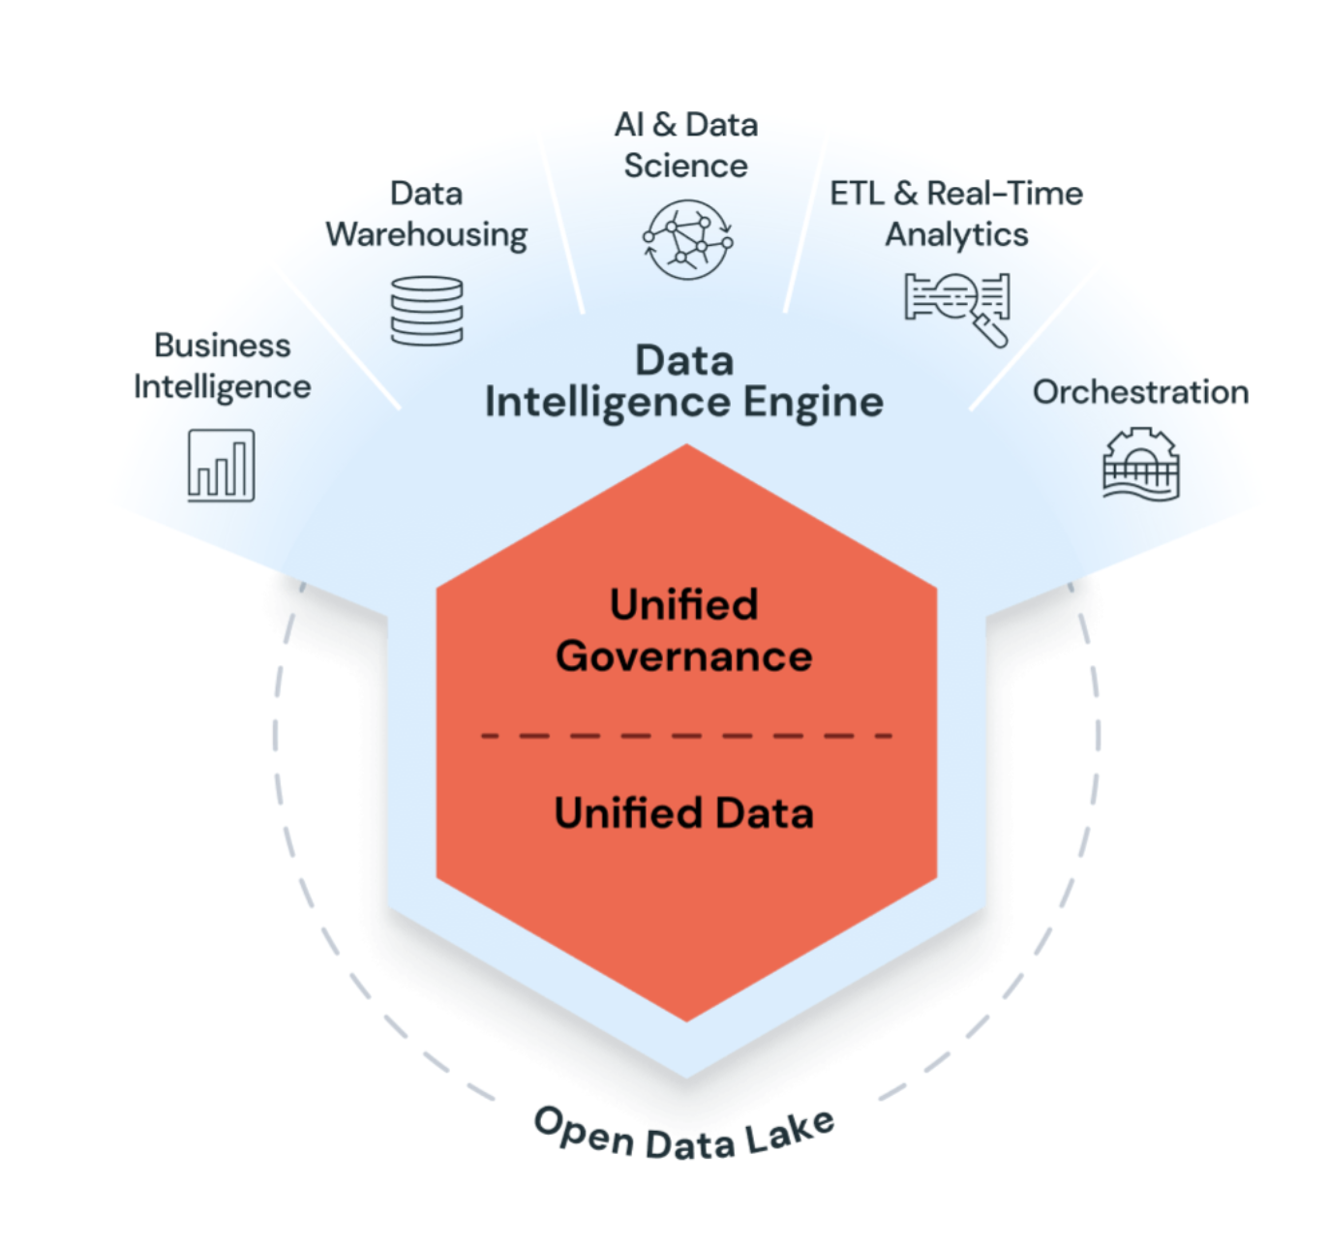
Azure Databricks Introduction
Azure Databricks is a unified, open analytics platform for building, deploying, sharing, and maintaining enterprise-grade data, analytics, and AI solutions at scale. The Databricks Data Intelligence Platform integrates with cloud storage and security in your cloud account and manages and deploys cloud infrastructure for you

Slide 10
Azure Databricks Core Components
Azure Databricks contains the following components –
Databricks Account -An Azure Databricks account represents a single entity that can include multiple workspaces. Accounts enabled for Unity Catalog can be used to manage users and their access to data centrally across all of the workspaces in the account
Databricks Workspace - In Azure Databricks, a workspace is an Azure Databricks deployment in the cloud that functions as an environment for your team to access Databricks assets.
Databricks Unit (DBU) - Azure Databricks bills based on Databricks units (DBUs), which are units of processing capability per hour based on VM instance type.

Slide 11
Wrap Up
Azure SQL Server Elastic Pools
Azure Storage Types & Blob Storage
Azure Data Lake Storage Gen2
Azure Databricks Overview

